Slide 1
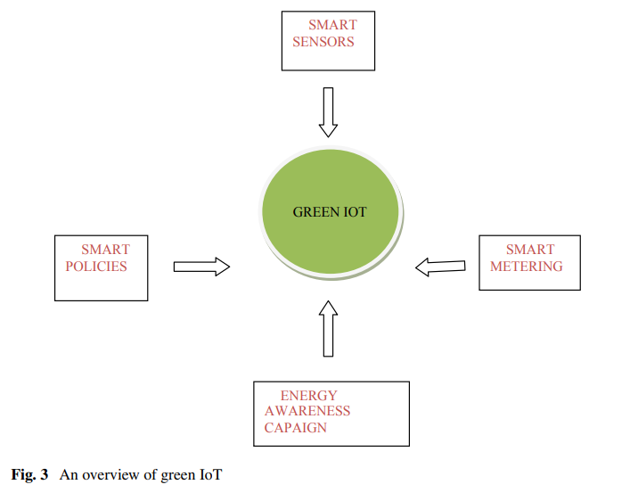
Green IoT: An Overview
Green IoT indicates energy efficiency in IoT.
Green IoT comprises methods for reducing energy consumption and how sensors can be efficiently used as an indication of energy conservation

Slide 2
As shown in the picture, smart sensors and usage of smart metering are leading to the implementation of green IoT
Implementation of effective energy usage policy and energy awareness campaigns are also leading to the concept of green IoT
Green IoT also includes the concept of how IoT can be utilized to reduce energy consumption.
Using the IoT sensors, electric devices can be disconnected from power supply or convert into power saving mode if being unused

Slide 3
Smart Homes
The idea of the smart home is all about IoT-enabled home, so that all things in the home can be sensed and monitored remotely.
It leads to make energy-efficient decisions so as to reduce the energy consumption.
For example, we can switch on, off, or regulate the temperature control system based on the surroundings even if we are away from the home, leading to a lot of energy savings
All home appliances will be attached to a sensor and can be controlled remotely, even from a mobile phone.
Example for some of the common sensors used in the smart home system is wireless temperature sensor, wireless door sensor, etc.

Slide 4
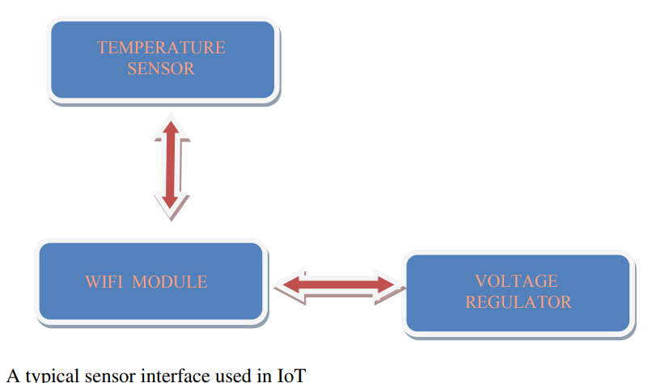

Slide 5
Smart Cities
Smart city is a concept of a city in which everything is linked to the Internet through IoT-enabled devices.
By wisely monitoring the readings from the IoT sensors, we can make intelligent decision leading to great deals of energy savings in the smart city.

Slide 6
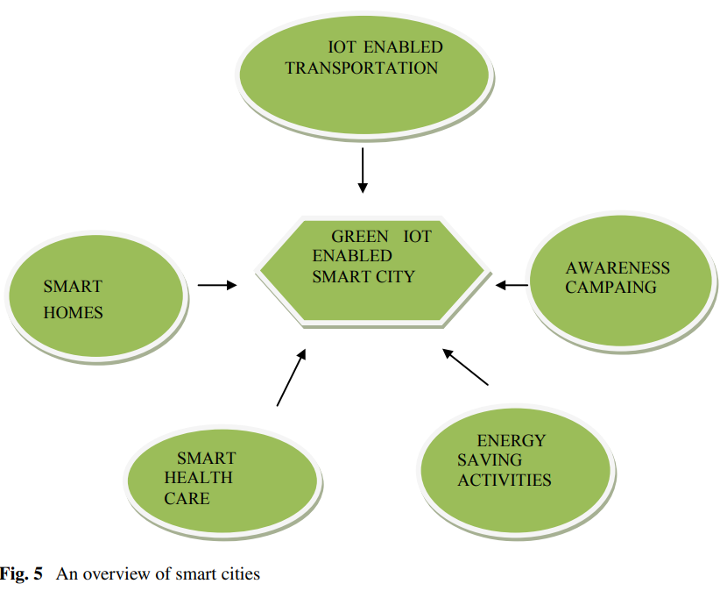

Slide 7
Energy-Efficient Smart Health Care
An efficient monitoring and diagnosis can be performed by IoT-enabled healthcare devices.
The data collected from the sensors will provide doctors a very clear idea about the nature of diseases and lead them to accurate diagnosis.
Through these efficient IoT devices, a doctor can monitor his patient even remotely.
Similarly, by utilizing the readings from the IoT sensors, we can regulate the energy usage in a hospital environment.
By effectively combining the insights from the IoT sensors, we can have an efficient energy usage pattern in a hospital, so as to minimize energy wastage and leap toward energy efficiency

Slide 8
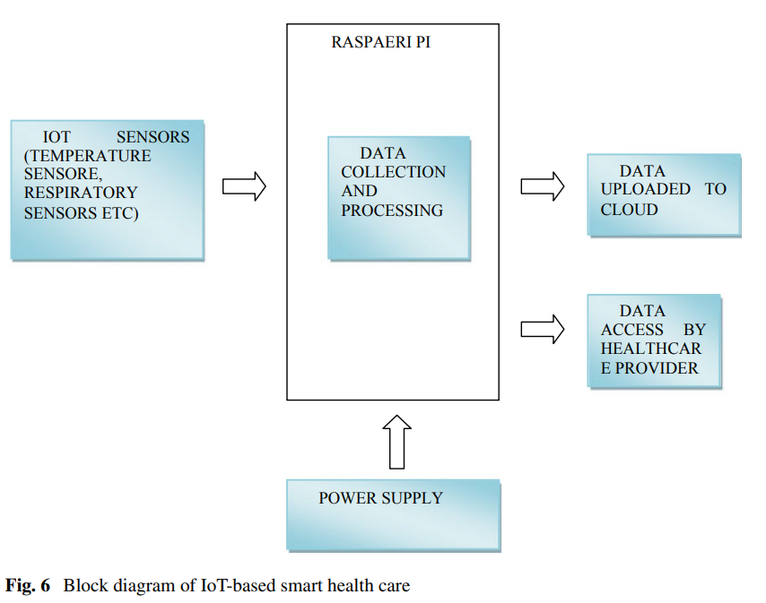

Slide 9
Various Approaches to Achieve Green IoT
describes different methodologies to make IoT green
categorizes these methodologies as software-based methodologies, hardware-based methodologies, policy-based methodologies, awareness-based methodologies, etc
One of the software-based techniques is to have a scheduling algorithm for sensors which will change the status of sensors to on duty and off duty based on the requirement of sensing
Another is an optimal workload distribution among server based on resource and energy consumption of servers

Slide 10
Designing smart integrated chip is one way to save energy which applies the hardware-based approach toward green IoT
This technology will combine green sensor on a chip, thereby combining processing power and sensing together and simplifying the sensor nodes.
Time reversal technique is used to power the sensors from radio frequency signals from surroundings.
It reduces power consumption to a great extent.

Slide 11
Usage of dual-core processors in IoT also helps in reducing the energy usage.
Out of the two cores, CoreL will be used for low computation task and CoreH will be used for high computation tasks.
This architecture reduces energy consumption by allocating low computation task to CoreL and high computation tasks to CoreH without wasting resources
A hierarchical architecture-based approach utilizes a cluster head having information about neighboring sensors and routers
These cluster head will perform efficient resource allocation in order to reduce energy consumption.

Slide 12
Reducing the amount of hardware by using the sensor on chip technology also helps in achieving energy efficiency
Policies and strategies based on real-time data obtained from sensors can support green energy concept to a great extent.
The insight drawn by processing the data obtained from IoT sensors can be best utilized to create energy usage policies.
Efficient policies need to be implemented in different stages like energy data collection, information processing, service delivery, etc.
Changing habit toward saving energy is another approach to save energy

Slide 13
By making positive changes in energy usage of user, great deal of saving can be achieved.
Behavioral changes can be achieved by making the user aware of the need to save energy.
Awareness campaign plays a vital role in making behavioral changes.

Slide 14
Awareness-Based Approach Toward Green IoT
If we make the users aware of their energy usage and current energy need, it will create a positive thinking toward saving energy
Energy Awareness Campaigns
Energy awareness campaign is defined as a properly planned, synchronous set of activities leading to create awareness among the energy users regarding the need of saving energy.
Readings from IoT sensor-enabled devices can be recorded and displayed to create awareness about current consumption and predicted future energy needs.
It will create a clear picture among viewers regarding the need to save energy and reduce consumption.

Slide 15
Energy campaigns at school are a greater way to create awareness among children.
Through placards, videos, displays, posters, awareness themed games, we can have students aware about the concept of green IoT.
The main steps involved in awareness campaign process are planning the campaign, identifying the prospective audience, collecting real-time data, creating campaign materials by properly utilizing the data, identifying strategies for delivering campaign, conducting the campaign effectively, and finally analyzing the results

Slide 16
Businesses also will have long-term benefits of conducting energy awareness campaigns.
The awareness about green IoT will lead to a great deal of energy-saving activities in an office environment. Energy awareness campaigns can be planned specifically based on the nature of business and types of energy usage.
Some of the positive steps involved in the campaign can be advising employees to adopt an energy-saving atmosphere, encouraging employees to identify to the area where they can save energy, displaying energy awareness slogans in the office building, etc.
Types of campaigns are highly dependable on the nature and domain of business.

Slide 17
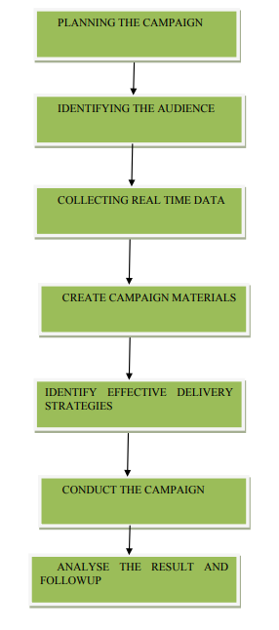
Steps involved in energy awareness campaign

Slide 18
IoT-Based Smart Metering
IoT-based smart meters are a great way to save energy.
A smart meter provides real time energy readings, and it is a good way to make user aware of the energy consumption.
The main benefits of smart meters are as follows: they are less error prone and more accurate, meter readings can be sent remotely through web, and they can be programmed to use with home appliances to control the energy usage to a great extent.
The data collected by these smart meters will be utilized to understand the usage pattern and to predict the future energy usage.
Some of the functionalities of a smart meter are to provide qualitative measurement, control and calibration, power management, synchronization, and display

Slide 19
In home area network, all home appliances will be connected to the smart metering.
All appliances can be controlled and power consumption can be regulated using this model. Wi-Fi and Bluetooth technologies can be used to connect home appliances to the smart meter
In neighborhood area network, multiple homes are connected through a single data aggregator unit.
They will collect data from participating home area network via a home area network
Wide area network will send data collected from data aggregator unit to power management system

Slide 20
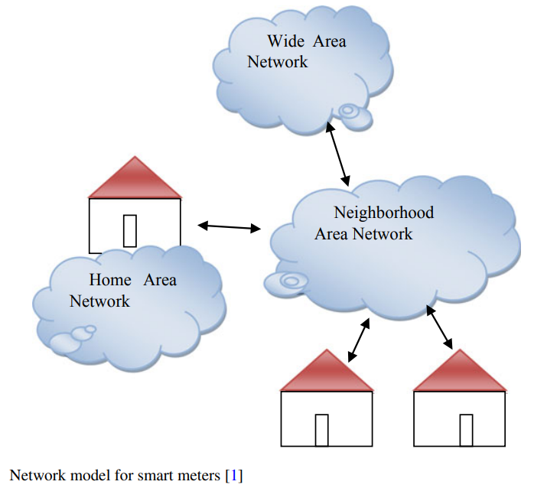

Slide 21
Promoting Recycling
Use of biodegradable materials can contribute toward reducing the greenhouse effect and carbon footprints
IoT will lead to billions of devices being part of the Internet and managing the e-waste will become a huge problem.
Use of biodegradable devices can contribute a lot to deal with this problem.
For example, we can recycle parts of a mobile phone wisely, like the nickel–cadmium battery can be recycled to create new battery, the copper and circuits can be recycled to create new circuit, and plastic can be reused to produce new plastic materials

Slide 22
Methods like selection of green materials, extension of contract length, inclusion of energy-saving battery, and reduction of packaging materials will reduce the environmental impact caused by cell phones
Promoting the use of recyclable materials in IoT network will make it environment-friendly and contribute toward reducing carbon footprint and greenhouse effects

Slide 23
Promoting the Usage of Sensor Cloud: A Step Toward Green IoT
Sensor clouds combine the capabilities of wireless sensor networks and cloud computing
Promoting the use of sensor cloud network will be a good step toward promoting green IoT.
Sensor cloud models involve ubiquitous sensors which collect information from surroundings and these data will be stored in the cloud infrastructure provided by cloud service providers.
Energy efficiency is also can be increased with the sensor cloud technology.
Analytical results show the greater increase in sensor lifetime in sensor cloud network compared to traditional wireless sensor network.

Slide 24
Researchers are trying to enhance sensor cloud network by the addition of technologies like novel sensory data processing framework (NSDPF) which connect sensor cloud network with mobile networks.
Scheduling mechanisms like location-based sleep scheduling will increase the energy efficiency of sensor cloud networks.
As per this technique, sensors will switch to sleep and awake mode based on the requirement and mobile location.
This leads to decrease in energy consumption as sensors will go to sleep mode if no sensing is needed.
This will save a lot of energy considering the huge amount of sensors being used.

Slide 25
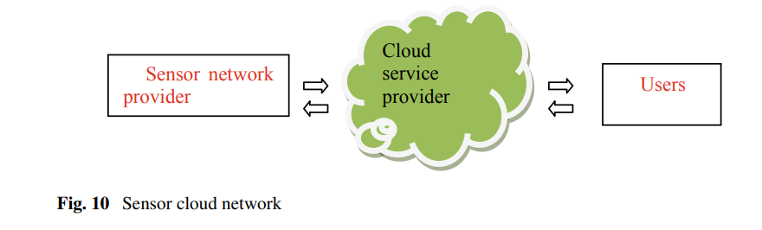

Slide 26
Creating Awareness Through Prototyping: A Green IoT-Based Smart Home Model
Prototyping is an important way to create awareness. In prototyping, a model will be created and statistics from this model will be taken.
These statistics will be used as a proof of concept for the implementation.
In a smart home, all appliances will be equipped with IoT-based sensors and can be monitored effectively with minimum human intervention.
Using IoT, we can even track the behavior of inhabitants and make better energy-saving decision based on their behaviors.

Slide 27
As part of the prototyping, we can have a model home installed with IoT sensors and can measure how effective usage and proper planning will help in saving a lot of energy.
This reading will lead us to make better energy saving decisions.
This model can be utilized for energy-saving campaigns as well.
A smart home will be equipped with smart meters which will provide frequent energy readings.
Displaying the energy usage information will contribute toward changing the user behaviors to support energy savings

Slide 28
Monitoring Energy Consumption
In smart home, there will be various devices out of which some will be always connected to the electric network.
Some others will be occasionally connected.
By effectively monitoring and organizing the connectivity patterns, some significant amount of energy savings can be attained.
Another aspect worth monitoring is the occupant’s behavior and energy usage patterns.
Energy consumption is greatly associated with the behavior and comfort choice of inhabitants.

Slide 29
Energy consumption will vary based on the weather conditions and geographical location.
Well-planned monitoring and observation are necessary to create a robust behavioral model.
The main parameters of consideration in defining a behavioral model will be the comfort choices of inhabitant, environmental condition, and activity levels of residents.
By intelligently monitoring the energy consumption, future energy usage can be predicted and will regulate the energy usage accordingly

Slide 30
A Robust Information Management and Automation System
The collected readings and data must be properly communicated and managed in order to make wise decisions.
It can provide intelligent adaptation countermeasure to users and connected automated device
An efficient automation system also can do a big role in energy savings.
Such a system will be well equipped to take readings from environment, and this information will be wisely utilized to control other connected subsystems in an efficient pattern.
Sensors and actuators will be allocated based on need. Some areas need frequent or continuous sensing should have more sensors installed, while some other areas may have comparatively less number of sensors installed

Slide 31
User Feedback and User Involvement for Energy Savings
User involvement is very critical in any energy-saving initiative.
The readings from the prototype implementation will be given to user and collect their feedback toward it.
Later, energy-saving decision will be taken in such a way as to accommodate these user feedbacks.
Readings from smart meters will be given to users and through proper awareness campaigns have users’ practice energy-saving behaviors.
By properly accommodating these user feedbacks, efficient energy-saving strategies can be implemented.

Slide 32
